Slide 1
Object- Oriented Programming (CS201)
Lecture 7
Encapsulation(1)

Slide 2



The four OOP Principles
Abstraction
Encapsulation
Association
Polymorphism
Object-Oriented Relationships
Association
UML symbol
Aggregation : has a
Composition: owns a
Inheritance : is a
Implementation : provides a

Slide 3
Objects & classes
Real-world objects share two characteristics: they all have state and behavior.
in your program, you will have software objects which are objects that you want to manipulate.
The state of an object is represented by variables with their current values.
The behavior of an object is defined by a set of methods
The terms object and instance are interchangeable.
Objects of the same type are defined using a common class.
The class defines the type of variables the object can have and the type of method the object can execute.
Radio
Radio might have states (on, off, current volume, current station) and behavior (turn on, turn off, increase volume, decrease volume, seek, scan, and tune).

Slide 4
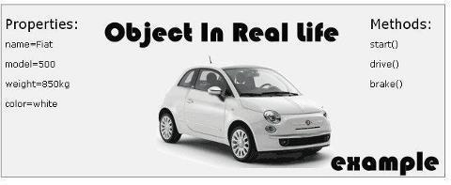
class Car
{
String name;
int model;
int weight;
String color;
void start(){……}
void drive(){……}
void brake(){……}
}

Slide 5
Abstraction
Abstractions is formed by reducing the information content of a concept typically to retain only information which is relevant for a particular purpose
Abstraction design : abstraction reduce and factor out details so that one can focus on a few concepts.
Abstraction allows the design stage to be separated from the implementation stage of the software development.
class Person{
String name;
Date birth;
….
boolean isAdult()
{….}
….
}
class Course{
String code;
int numOfStudents;
….
boolean isFull()
{….}
….
}
Notes:
abstraction: A distancing between ideas and details.
You understand its external behavior (buttons, screen, etc.)
You DON'T understand its inner workings, nor do you need to.
Specifying what an object can do without specifying how it does it is an abstraction.

Slide 6
Example 1 : Abstraction of a Credit Card
public class CreditCard{
double limit;
int number;
double balance;
static final double MAX_LIMIT=20000;
public CreditCard(int number){
this.number=number;
}
public void setLimit(double limit){
If(limit<=MAX_LIMIT)
this.limit=limit;
else return;
}
public boolean buyWithCredit(double amount){
if ((balance+amount)>limit) return false;
balance=balance+amount;
return true;}
public void creditSettle(double amount){
balance=balance-amount;
}
}
Misuse of class
class Test{
public static void main (String [] arg){
CreditCard card1=new CreditCard(345);
card1.setLimit(5000);
card1.buyWithCredit(500);
card1.buyWithCredit(1500);
card1.limit=100000;
card1.buyWithCredit(15000);
}
}

Slide 7

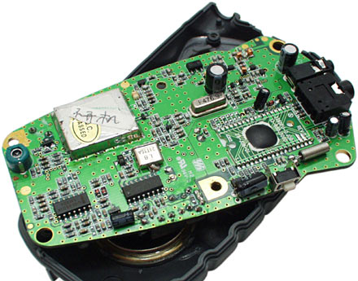
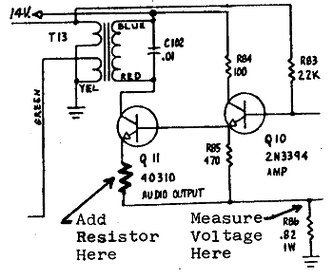

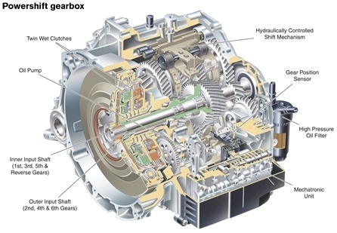
Encapsulation
A language construct that facilitates the bundling of data with the methods operating on that data (this is achieved using the class structure)
A language mechanism for restricting access to some of the object's components, (this is achieved using access modifiers)
A class should encapsulate only one idea , i.e. a class should be cohesive
Your Encapsulation design should minimize dependency in order to ensure that there is a loose-coupling
class AutoTransmission
{
private int valves;
void shiftGear()
{……………….}
}
Notes:
The class is the mechanism by which encapsulation is achieved in Java.
the internal representation of an object is generally hidden from view outside of the object's definition. Typically, only the object's own methods can directly inspect or manipulate its fields

Slide 8
Better Encapsulation of class CreditCard
public class CreditCard{
private double limit;
private int number;
private double balance;
public static double fimal MAX_LIMIT=2000;
public CreditCard(int number){
this.number=number;
}
public void setLimit(double limit){
If(limit<=MAX_LIMIT)
this.limit=limit;
else return;
}
public boolean buyWithCredit(double amount){
if ((balance+amount)>limit) return false;
balance=balance+amount;
return true;
}
public void creditSettle(double amount){
balance=balance-amount;
}}
class Test{
public static void main (String [] arg){
CreditCard card1=new CreditCard(345);
card1.setLimit(5000);
card1.buyWithCredit(500);
card1.buyWithCredit(1500);
card1.limit=100000;
Card1.setLimit(100000);
card1.buyWithCredit(15000);//return false
}
}

Slide 9
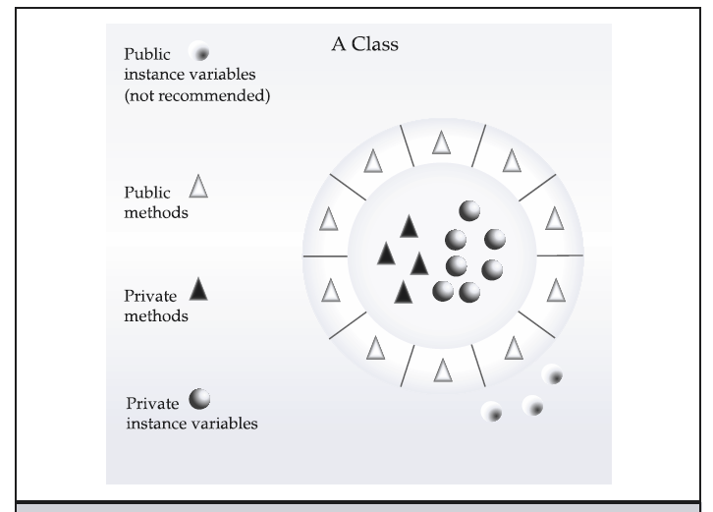
Encapsulation

Slide 10
Data Field Encapsulation
Instance variables are declared private to prevent misuse.
providing methods that can be used to read/write the state rather than accessing the state directly.
public class Person{
private int age;
public void setAge(int age ){
if (age<0)
{
System.out.println("unaccepted value");
return;
}
this.age=age;
}
public int getAge(){
return age;
}
}
Person p1=new Person();
p1.age=10;
System.out.println(p1.age);
Person p1=new Person();
p1.setAge(10);
Notes:
To prevent data from being tampered with and to make the class easy to maintain,
most of the data fields in this book will be private.

Slide 11
Accessors and mutators
Data Field Encapsulation
public class Person{
private int age;
private String name;
private boolean adult;
public int getAge()
{return age;}
public void setAge(int age )
{this.age=age;}
public String getName()
{return name;}
public void setName(String name)
{this.name=name;}
public boolean isAdult()
{return adult;}
public void setAdult(boolean adult)
{this.adult=adult;}
}
Instance variables are declared private to prevent misuse.
providing methods that can be used to read/write the state rather than accessing the state directly.
Accessor method (getters): a method that provides access to the state of an object to be accessed.
A get method signature:
public returnType getPropertyName()
If the returnType is boolean :
public boolean isPropertyName()
Mutator method(setters): a method that modifies an object's state.
A set method signature:
public void setPropertyName(dataType propertyValue)
Notes:
To prevent data from being tampered with and to make the class easy to maintain,
most of the data fields in this book will be private.

Slide 12
Example :Class GasTank
Write a class named GasTank containing:
  An instance variable named amount of type double, initialized to 0.
  A method named addGas that accepts a parameter of type double . The value of the amount instance variable is increased by the value of the parameter.
  A method named useGas that accepts a parameter of type double . The value of the amount instance variable is decreased by the value of the parameter.
  A method named getGasLevel that accepts no parameters. getGasLevel returns the value of the amount instance variable.

Slide 13
public class GasTank {
private double amount = 0;
public void addGas ( double doubleAmount)
{
amount += doubleAmount;
}
public void useGas ( double doubleAmount)
{
amount -= doubleAmount; }
public double getGasLevel () {
return amount;
}
}

Slide 14
Example 2 :Class MusicAlbum
Implement Class MusicAlbum which encapsulated a music
Album, each album has a string variable albumTitle and a String
variable singer representing the name of singer, double variable
price representing the price of album, objects of this class are
Initialized using all of its instance variables.
The class has accessor methods for all its Variables and a
mutator method for price

Slide 15
public class MusicAlbum {
private String albumTitle;
private String singer;
private double price;
Public MusicAlbum(String albumTitle, String singer, double price)
{
this.albumTitle=albumTitle;
this.singer=singer;
this.price=price;
}
public String getAlbumTitle()
{
return albumTitle;
}
public String getSinger()
{
return singer;
}
public double getPrice()
{
return price;
}
public void setPrice ( double price)
{
this .price=price;
}
}

Slide 16
Example 3 :Class Car
Design and implement a class called Car that contains instance data that represents the make, model, and year of the car (as a String, String and int values respectively). Define the Car constructor to initialize these values (in that order).
Include getter and setter methods for all instance data

Slide 17
public class Car {
private String make, model;
private int year;
public Car(String make, String model, int year) {
setMake(make);
setModel(model);
setYear(year);
}
public String getMake() {return make;}
public void setMake(String make) {this.make = make;}
public String getModel() {return model;}
public void setModel(String model) {this. model = model;}
public int getYear() {return year;}
public void setYear(int year){this.year=year;}
}

Slide 18
Elevator Case Study

Slide 19
Abstraction of Elevator
public class Elevator {
public boolean doorOpen = false;
public int currentFloor = 0;
public int weight = 0;
public final int CAPACITY = 1000;
public final int TOP_FLOOR = 5;
public final int BOTTOM_FLOOR = 0;
}

Slide 20
Improper use of class Elevator
public class PublicElevatorTest {
public static void main(String[] args) {
Elevator pubElevator = new Elevator();
pubElevator.doorOpen = true; // passengers get on
pubElevator.doorOpen = false; // doors close
// go down to floor -1 (below bottom of building)
pubElevator.currentFloor--;
pubElevator.currentFloor++;
// jump to floor 7 (floor 7 does not exist!!)
pubElevator.currentFloor = 7;
pubElevator.doorOpen = true; // passengers get on/off
pubElevator.doorOpen = false;
pubElevator.currentFloor = 1; // go to the first floor
pubElevator.doorOpen = true; // passengers get on/off
pubElevator.currentFloor++; // elevator moves w/ door open
pubElevator.doorOpen = false;
pubElevator.currentFloor--;
pubElevator.currentFloor--;
}
}

Slide 21
Comment on first design
Because the PublicElevator class does not use
encapsulation, the PublicElevatorTest class can change the values of its attributes freely and in many undesirable ways.
For example, on statement after // go down to floor -1, which might not be a valid floor.
Also, on the statement, pubElevator.currentFloor = 7,
the currentFloor attribute is set to 7 that, according to the TOP_FLOOR constant, is an invalid floor

Slide 22
Encapsulation Elevator
public class Elevator {
private boolean doorOpen = false;
private int currentFloor = 0;
private int weight = 0;
public final int CAPACITY = 1000;
public final int TOP_FLOOR = 5;
public final int BOTTOM_FLOOR = 0;
}

Slide 23
public class PrivateElevator1Test {
public static void main(String[] args) {
Elevator priElevator = new Elevator();
/*
* The following lines of code will not compile
* because they attempt to access private variables.
*/
priElevator.doorOpen = true; // passengers get on
priElevator.doorOpen = false; // doors close
// go down to floor -1 (below bottom of building)
priElevator.currentFloor--;
priElevator.currentFloor++;
// jump to floor 7 (only 5 floors in building)
priElevator.currentFloor = 7;
priElevator.doorOpen = true; // passengers get on/off
priElevator.doorOpen = false;
priElevator.currentFloor = 1; // go to the first floor
priElevator.doorOpen = true; // passengers get on/off
priElevator.currentFloor++; // elevator moves w/ door open
priElevator.doorOpen = false;
priElevator.currentFloor--;
priElevator.currentFloor--;
}
}

Slide 24
Comment on second design
The code does not compile because the main method in the PrivateElevator1Test class is attempting to change the value of private attributes in the PrivateElevator1 class.
The PrivateElevator1 class is not very useful, however,
because there is no way to modify the values of the class.
In an ideal program, most or all the attributes of a class are kept private.
Private attributes cannot be modified or viewed directly by classes outside their own class, they can only be modified or viewed by methods of that class. These methods should contain code and business logic to make sure that inappropriate values are not assigned to the variable or an attribute.

Slide 25
Better Encapsulation of class Elevator
public class Elevator {
private boolean doorOpen = false;
private int currentFloor = 0;
private int weight = 0;
public final int CAPACITY = 1000;
public final int TOP_FLOOR = 5;
public final int BOTTOM_FLOOR = 0;
public void openDoor() {
doorOpen = true;
}
public void closeDoor() {
calculateWeight();
if (weight <= CAPACITY) {
doorOpen = false;
} else {
System.out.println("The elevator has exceeded capacity.");
System.out.println("Doors will remain open until someone exits!");
}
}

Slide 26
// random weight for simulation
private void calculateWeight() {
weight = (int)(Math.random() * 1500);
System.out.println("The weight is " + weight);
}
public void goUp() {
if (!doorOpen) {
if (currentFloor < TOP_FLOOR) {
currentFloor++;
System.out.println(currentFloor);
} else {
System.out.println("Already on top floor.");
}
} else {
System.out.println("Doors still open!");
}
}

Slide 27
public void goDown() {
if (!doorOpen) {
if (currentFloor > BOTTOM_FLOOR) {
currentFloor--;
System.out.println(currentFloor);
} else {
System.out.println("Already on bottom floor.");
}
} else {
System.out.println("Doors still open!");
}
}

Slide 28
public void setFloor(int desiredFloor) {
if ((desiredFloor >= BOTTOM_FLOOR) &&
(desiredFloor <= TOP_FLOOR)) {
while (currentFloor != desiredFloor) {
if (currentFloor < desiredFloor) {
goUp();
} else {
goDown();
}
}
} else {
System.out.println("Invalid Floor");
}
}
public int getFloor() {
return currentFloor;
}
public boolean getDoorStatus() {
return doorOpen;
}
}

Slide 29
// PrivateElevator2Test.java
public class PrivateElevator2Test {
public static void main(String[] args) {
Elevator privElevator = new Elevator();
privElevator.openDoor();
privElevator.closeDoor();
privElevator.goDown();
privElevator.goUp();
privElevator.goUp();
privElevator.openDoor();
privElevator.closeDoor();
privElevator.openDoor();
privElevator.goDown();
privElevator.closeDoor();
privElevator.goDown();
privElevator.goDown();
int curFloor = privElevator.getFloor();
if (curFloor != 5 && !privElevator.getDoorStatus()) {
privElevator.setFloor(5);
}
privElevator.setFloor(10);
privElevator.openDoor();
}}
Notes:
privElevator.getClass();

Slide 30
Comment on third design
Because the PrivateElevator2 class does not allow direct manipulation of the attributes of the class, the PrivateElevator2Test class can only invoke methods to act on the attribute variables of the class.
These methods perform checks to verify that the correct values are used before completing a task, ensuring that the elevator does not do anything unexpected.
All of the complex logic in this program is encapsulated within the
public method of the PrivateElevator2 class. The code in the test class is, therefore, easy to read and maintain. This concept is one of the many benefits of encapsulation.

